Slide 1
Cancer Detection Progress Report
Team members:​
Savannah (Yuxuan) Sun; Jackey (Kai) Jia; Andy (Jiaze) Ma; Marvin Larweh
10/22/2024

Slide 2
Content
Recalling
Visualization of the Dataset
Results of Tests on Three Normal Datasets
Profile the Code
Timeline

Slide 3
Recalling-How to detect cancers
MIGHT (Multidimensional-Informed Generalized Hypothesis Technology)
Core Technique: Decision trees & forests
Strengths:
Universal applicability across datasets, variables, and outcomes
Optimizes dataset for specific biomedical outcomes (e.g., cancer types)
Flexible for early-stage cancer detection across diverse types

Slide 4
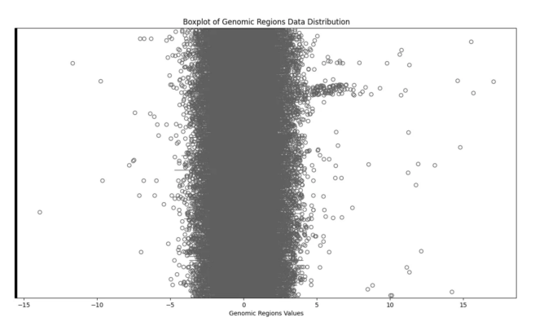
Visualization of the dataset
X - concentration of CG after normalization
Y - features (different part on chromosome)
Figure 1: Boxplot of all the samples that are NOT having cancer (Negative samples)

Slide 5
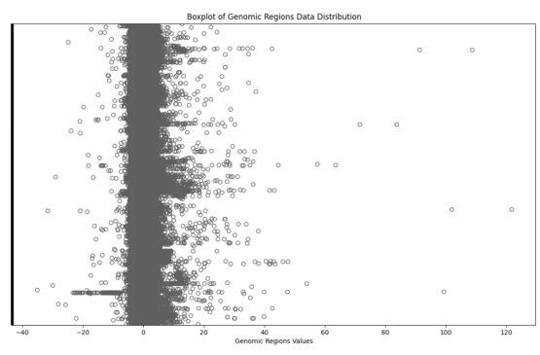
Visualization of the dataset
There are less extreme value in this class.
Max: about 15, Min: about -14
Figure 2: Boxplot of all the samples that are having cancer (Positive samples)
A lot of extreme values from -40 to 120

Slide 6
Visualization of the dataset
Question: What is the meaning of extreme data?
Significant Features or Bad Samples?

Slide 7
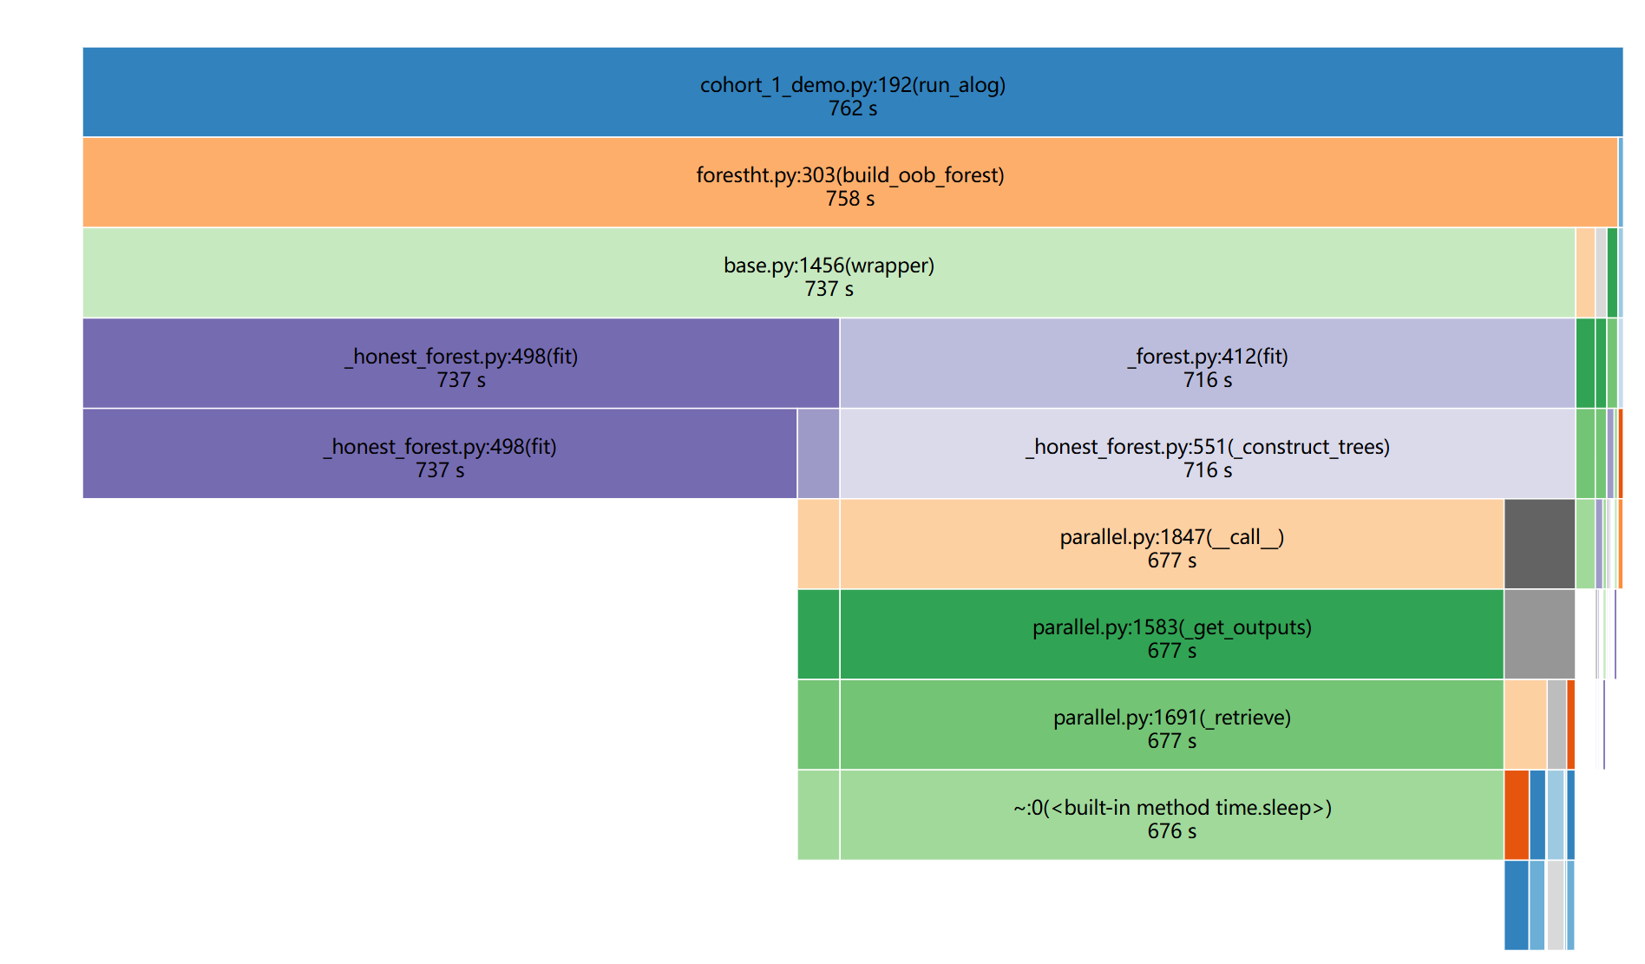
Results of Tests on Three Normal Datasets

Slide 8
Timeline - How long will it take?
Total Duration: Two semesters (~9 months)
Detailed Timeline:
Sprint 0: (08/27/2024 – 09/12/2024): Write project proposal & establish ML baseline
Sprint 1: (09/13/2024 – 10/17/2024): Replicate demo tests with different metrics
Sprint 2 (Mid-term): (10/21/2024 – 12/12/2024): Profile the code, identify slow functions
Sprint 3: (01/06/2025 – 02/04/2025): Improve the MIGHT algorithm
Sprint 4: (02/05/2025 – 03/03/2025): Implement improvements, test results
Sprint 5: (03/04/2025 – 04/07/2025): Achieve 10% efficiency improvement
Sprint 6 (Final): (04/08/2025 – 05/10/2025): Achieve 20% efficiency, submit final project
Done!

Slide 9
Thanks for watching!

